Slide 1
GDI Library Video Tips
Browsing library shelves from outside the library
Notes:
Welcome to the GDI Library series of video tips.

Slide 2
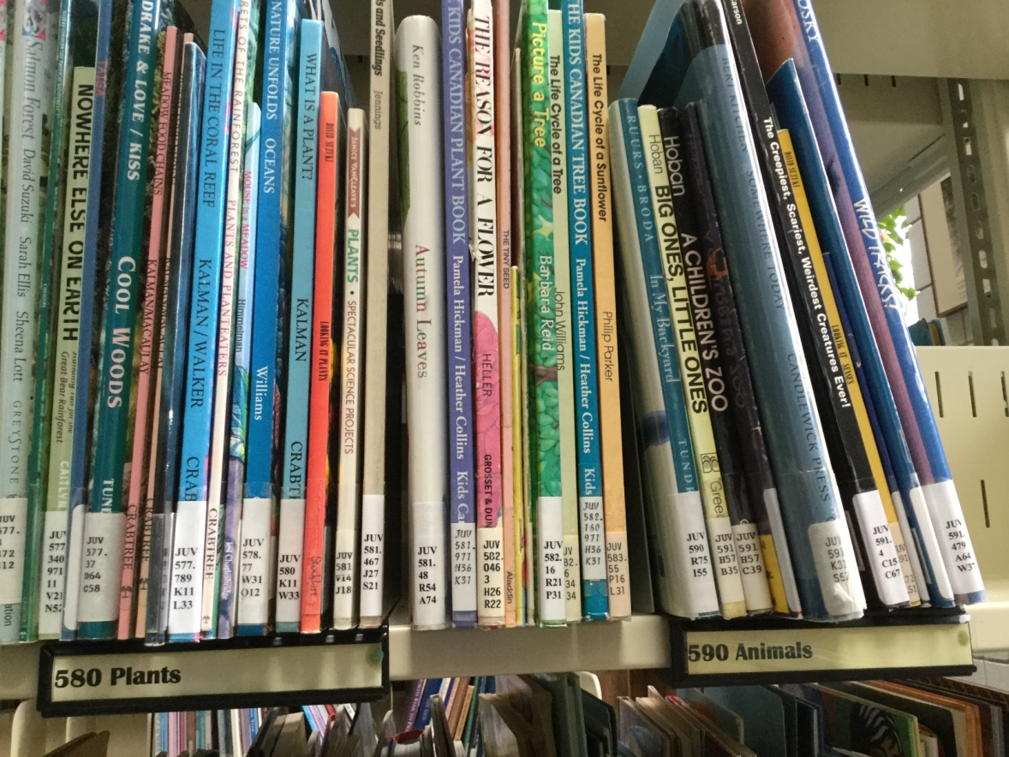
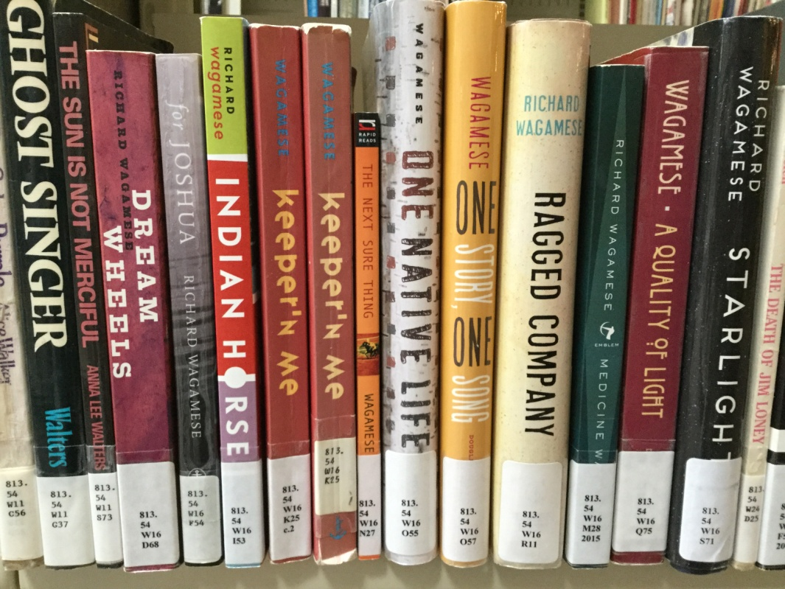
Non-fiction books on the similar subjects file together on the shelves
Fiction by the same author files together on the shelves
Notes:
To make it easier to find relevant resources, libraries keep non-fiction materials about the same subject, and fiction by the same author together on the shelves. When you’re not sure exactly what you’re looking for, finding one really relevant item and browsing the shelves in its immediate vicinity is often a useful strategy for finding other useful items.
When it’s not possible to browse the shelves in person, you can do so virtually from any internet-connected device. Here’s how.

Slide 3
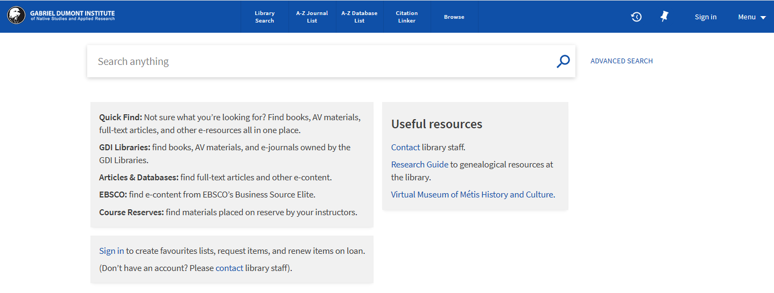
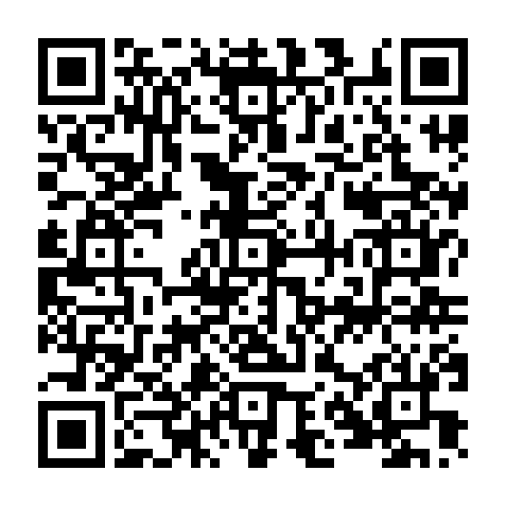
Library Catalogue: https://tinyurl.com/gdilib
Notes:
Get started by going to the library’s catalogue. Use the URL on your screen, or scan the QR code on your mobile device.

Slide 4
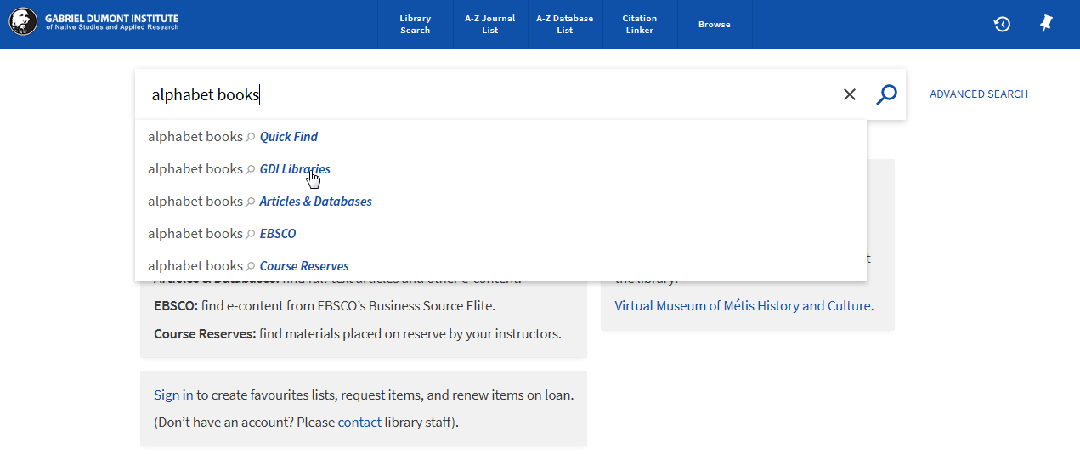
Notes:
Do a search for a topic or an author, or a book title if you already have a relevant resource in mind. For this demo, we’ll search on the topic of “alphabet books.” Because we’re interested in seeing the physical materials available in the library (and not as interested in digital content, which doesn’t appear on library shelves), we’ll search in the “GDI Libraries” scope. For more information about search scopes, please see the video on that topic.

Slide 5
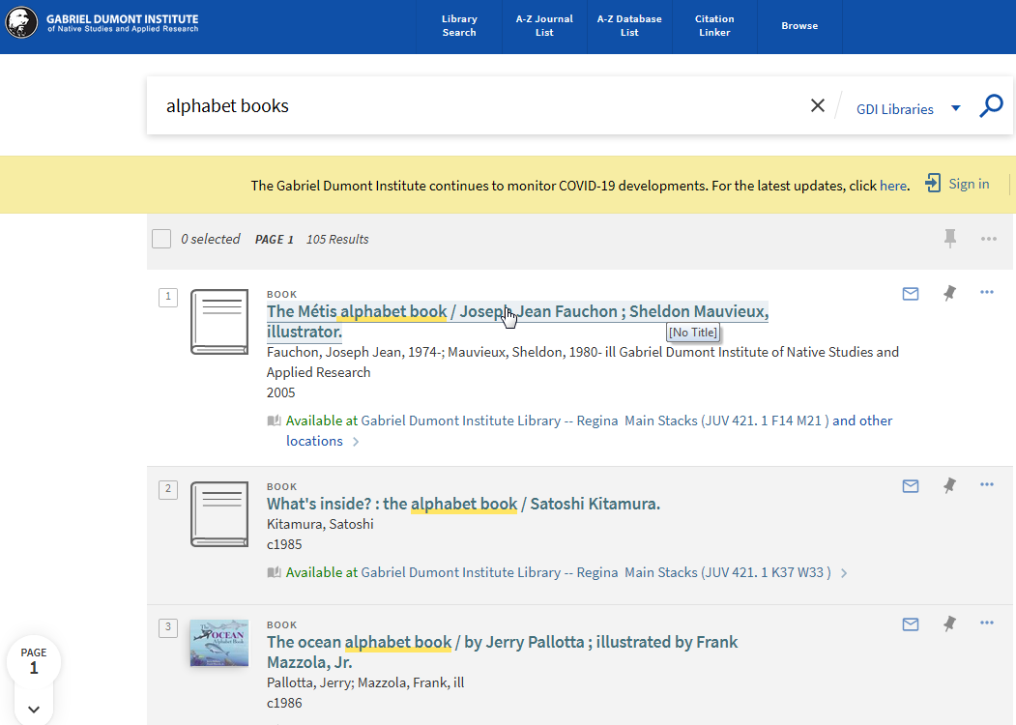
Notes:
From the search results, choose one of the items that looks relevant, and click on it.

Slide 6
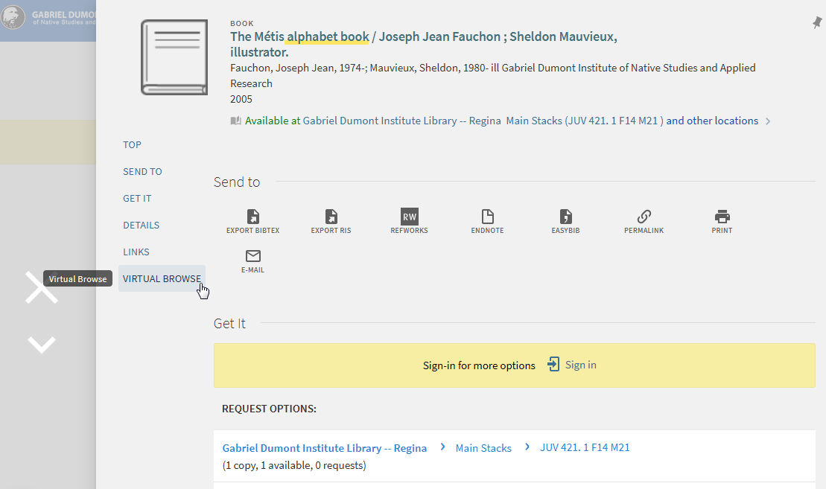
Notes:
Once you’re in the record, you can click on the “Virtual Browse” link on the left side of your screen…

Slide 7
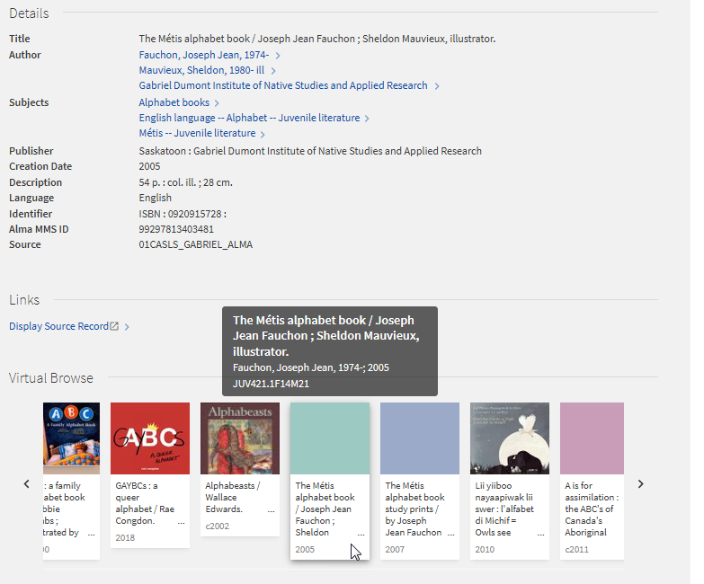
Notes:
…or you can simply scroll down to the bottom of your screen. The item you originally clicked on will be in the middle of the display; you can click on the arrows to the left and right to see other materials shelved near that book.

Slide 8
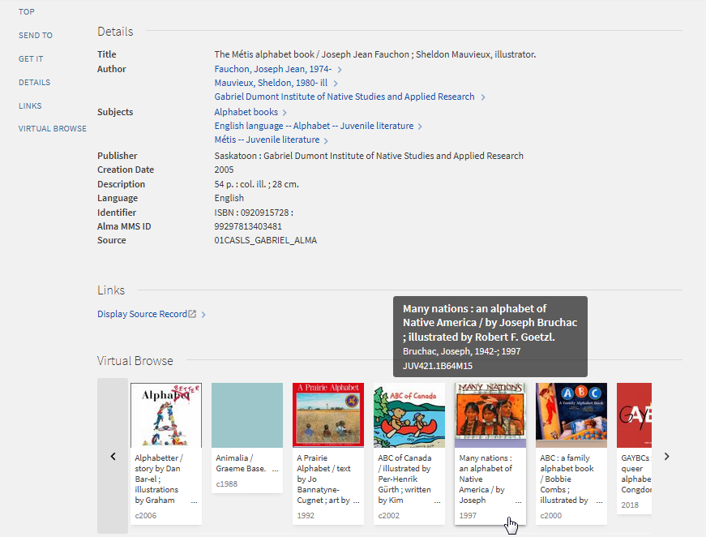
Notes:
If any of these look interesting, you can click on the book cover to see additional details…

Slide 9
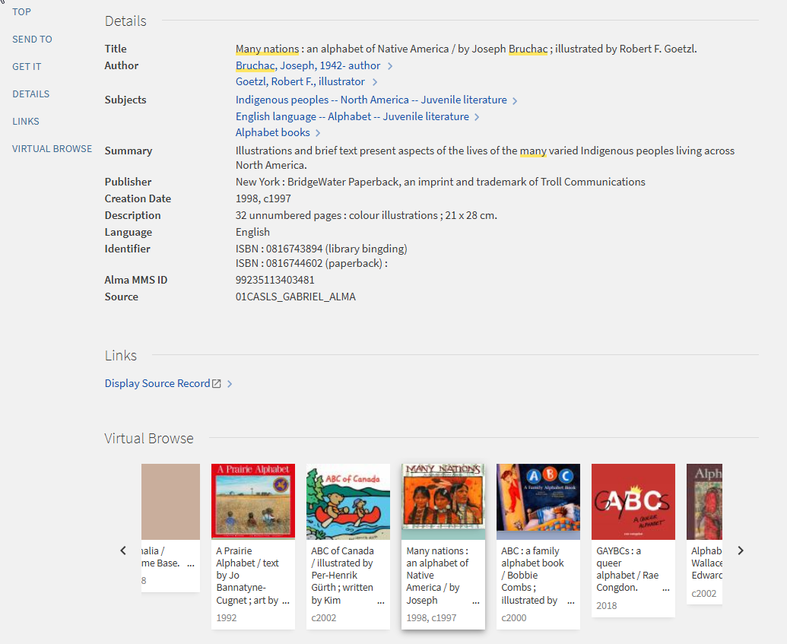
Notes:
…including subject headings, a summary in some cases, and the length of the item. When you’re ready to continue browsing, scroll down to the “Virtual Browse” section again.

Slide 10
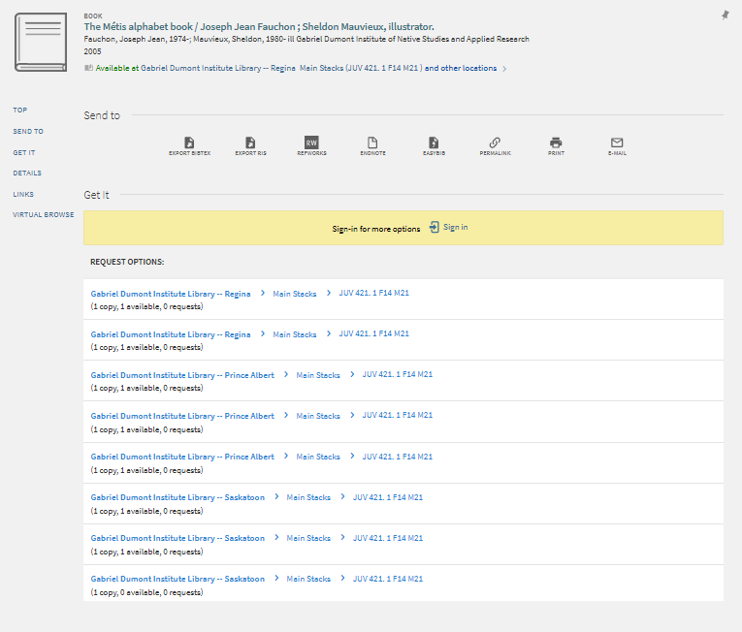
Notes:
Remember that the virtual browse includes physical materials from all three GDI Library branches in the province, including Prince Albert, Regina, and Saskatoon. Check the “Get It” section of catalogue records to see where the material is physically located, and whether it is available. If you need help requesting materials from other branches in the province, please see the video on that topic, or ask staff for assistance.

Slide 11
Thanks for watching!
Library Catalogue: https://tinyurl.com/gdilib
Contact: https://gdins.org/student-services/library/contact/
Notes:
Thanks for watching! Be sure to contact staff if you run into difficulty, or have other questions about library services.

